Slide 1
Commercial Software Development Writing software is easy, not going bust is the hard bit
Liam Westley
NDC London, 3rd December 2014
All code and slides will be available at
https://github.com/westleyl/NDCLondon-2014

Slide 2
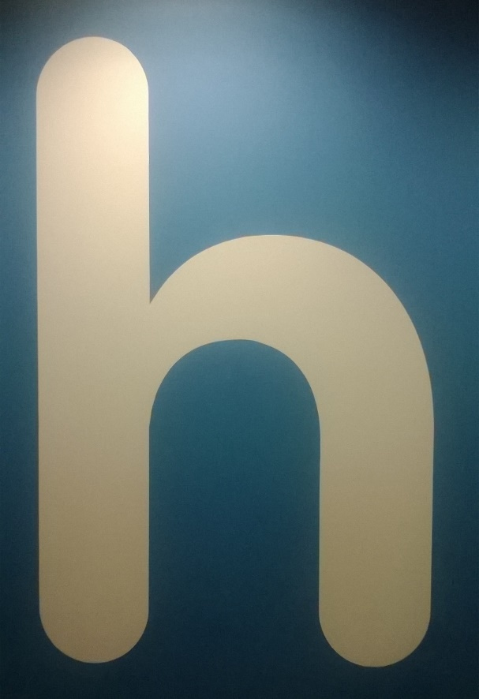
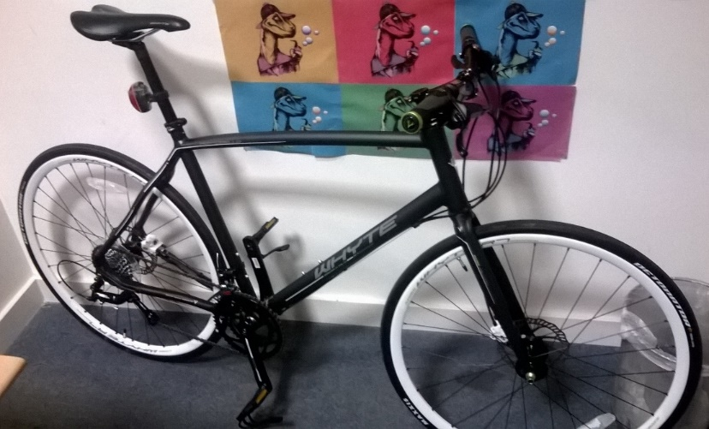

Who is Liam Westley?
< commute
play >
< work

Slide 3
Assumptions
You can write code
You will work hard
You have sales leads
Notes:
Also – this is not going to deal with any specific technology framework, not concentrate any specific methodologies.
This is much more a talk about fundamental business processes that I believe remain valid irrespective of the technologies or methodologies being used.
This is definitely a subjective and personal view, but it is based on real world experiences over the past 20 years.

Slide 4
2 BH - Liam’s Industry Experience
Lighthouse Computer Graphics
Sky News weather system, GMTV
Phoenix Computer Services
BSkyB; elections, weather, sport
Tiger Computer Services Ltd
Hat Trick Productions, QVC UK, chellomedia, GMTV (again), NHS booking systems
Original Thinking Group Ltd
Sky Interactive chat rooms, Tiger Aspect Productions, Hat Trick Productions
CriteriaMX
Digital media startup for MP3 music downloads
Notes:
In my entire career since leaving university at the age of 22, the longest I have worked for a single company, 9-5, 5 days a week, is six months (a dot.com spinoff that went tits up within 6 months). At all other times I was either freelancing, contracting, part time or owned a significant amount of the company for which I was working.
Commercial Software Development in this presentation refers to working for external clients, either developing software products or bespoke software. It may not always apply to teams delivering software to other internal departments in the same company.
I realise that some companies can run software development internally along the lines of a separate company, but generally, despite using terms such as ‘clients’ for other departments within the same company there are neither the same business constraints or the degree of flexibility that an external software development company experiences.

Slide 5
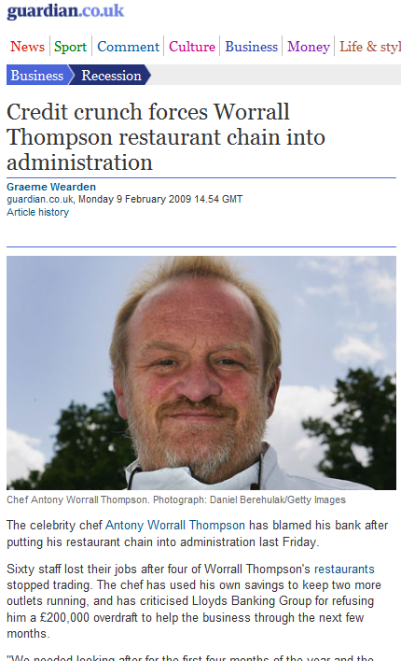
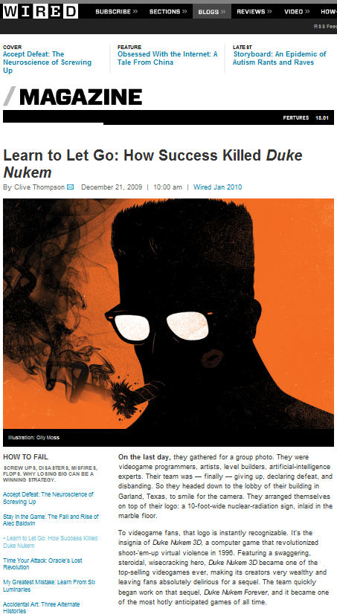
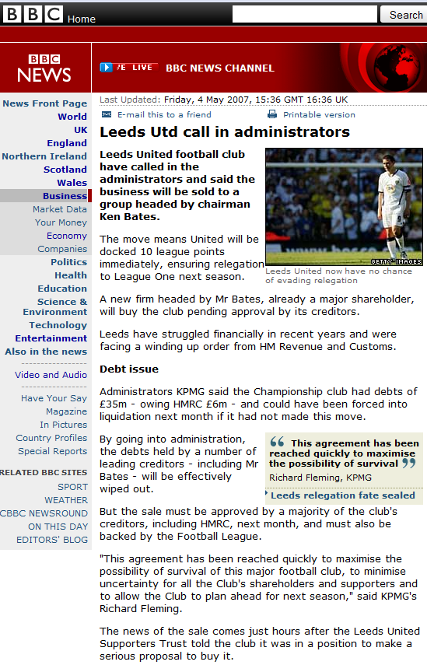
Liam’s top 3 ways to lose money

Slide 6
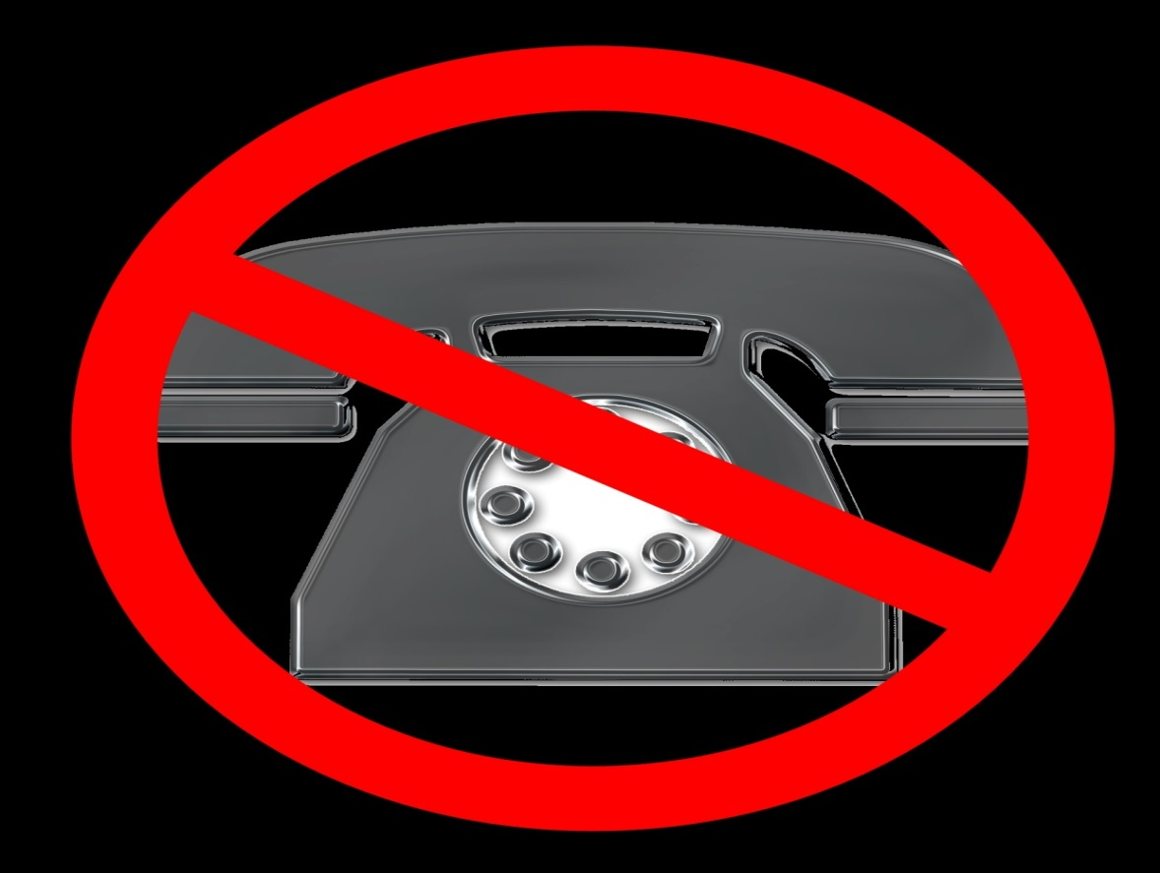
No.1 – Support
image (c) Kriss Szkurlatowski http://www.sxc.hu/profile/hisks
Notes:
Support is always going to be tricky, especially for small software companies. Even if you have support and maintenance contracts which provide revenue I would still attempt to reduce support incidents to an absolute minimum. I always joked that Access MDB file corruption was made for consultants – regular calls and work compacting and repairing database files generating support call revenue. Of course, the client hates it, the programmer hates it and no one is really happy even if it gets fixed and life carries on.
5 SECONDS TO RING
<phone call – ‘Sorry, I’m a bit busy ... Oh ... well you need to click the close button ... it’s in the top right corner ... the red cross ... next to the two blue buttons with lines in them ... no, not the blue buttons, click the red cross. OK. Did you write down the error code you got before that ... Ah ... if it happens again could you write them down. Thanks.’ As I was saying ..... >
Your goal as a software company is to create software that never causes that support phone to ring.
The co-owner of The Original Thinking Group was definitely one to be careful with his cash, and so he taught me a valuable lesson. One of my jobs as a programmer was to ensure the phone never rang for support calls. His view; Every time the phone rings you bleed cash.

Slide 7

No.2 – Test, test and test again
\
Notes:
I believe the issue of testing is linked to No.1 – Support. By testing I don’t mean one final run through before handing it to a client. Ikea have machines that test someone repeatedly sitting on their chairs, which eliminates the boredom that an actual person would suffer of repeatedly sitting on a chair, and in addition, produces a repeatable test that can easily be implemented on improved models or different configurations (different cushions and fabrics).
If you want to reduce support costs one of your key aims should be to test your software thoroughly to ensure the software you create is reliable and robust. As the Test Driven Development guys will tell you, if you find bugs early in development, it massively reduces both the time taken to complete the software but vastly reduces support calls when the software goes live with the client. And that is before you have on site visits which are generally expensive, and can be awkward if the fault was not yours and therefore incurs costs the client was not expecting.
<Click to stop>
Original Thinking Group – automated IE 5.5 for Sky Chat system (2000), provided end to end testing.
In the past year I have adopted unit testing, initially what would be understood as integration testing as it still used a backend database during unit testing. More recent projects have had pure unit testing with mocks replacing database functionality. In the NHS patient booking system this has shifted the balance of development and test phase from around 70% / 30% to nearly 95% / 5% as very few bugs survive to be discovered in the UI testing of the main web application.

Slide 8

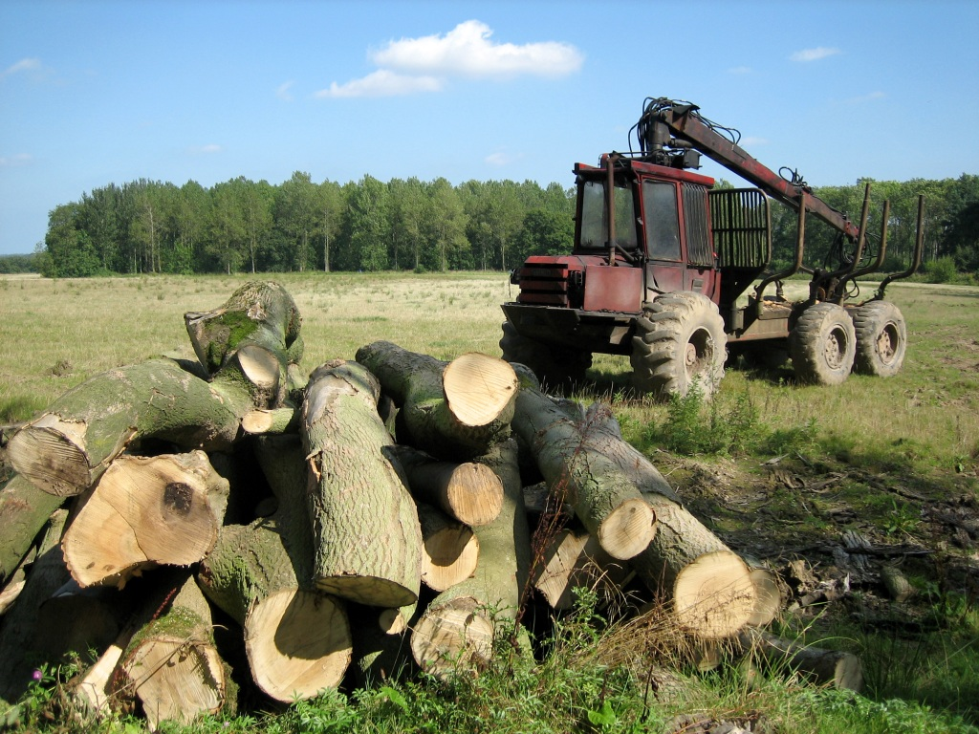
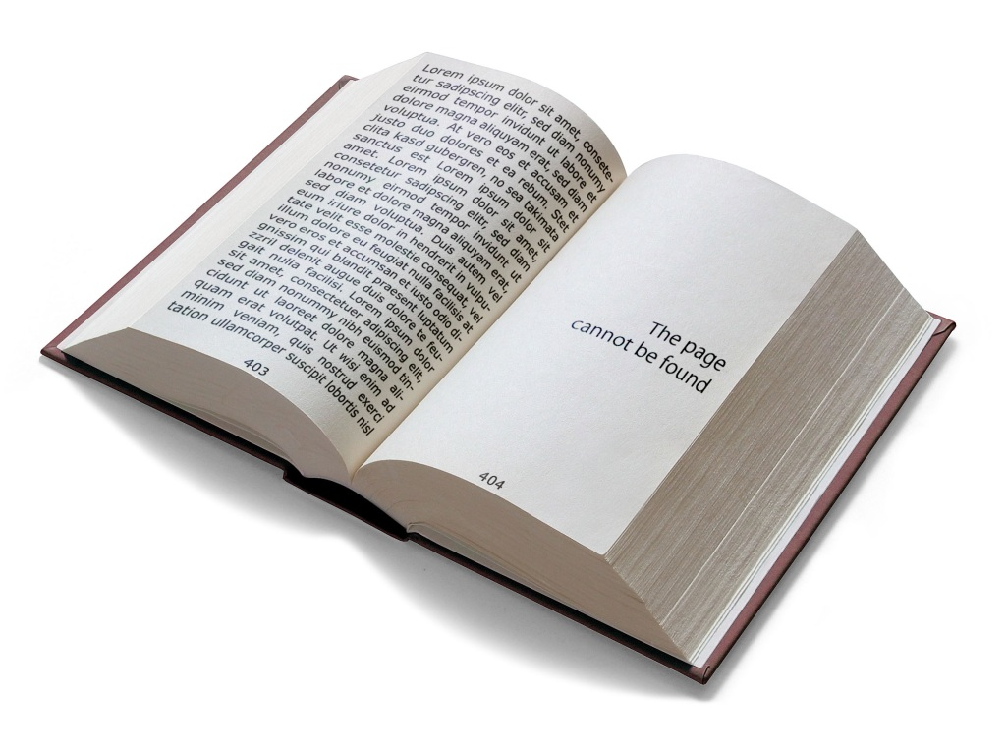
No.3 – Logging
stock.xchng
http://www.sxc.hu
Notes:
The kind of logging needed to diagnose things like 404 errors in web applications, where we might want more information that just the bare error code and limited information that would be provided from standard error handling.
<phone call – ‘Hello again. Ah, so it’s error 10345, ‘Null exception’. Hmmm, have you got the option to send the logfile via e-mail. Yeah, if you click that it’ll give me more information than the message box. If you continue for now I’ll have a look at the log file A.S.A.P. and get back to you’ >
There are lots of libraries for handle logging; you should be aiming at the Event Log, log files, e-mails or hosted solutions such as Exceptioneer. The Event Log is very good if you have local IT Pros on site, as they can set SNMP traps to monitor for error conditions and use their existing centralised tools. For smaller clients e-mails and hosted solutions provide a better experience as local IT knowledge may be minimal; talking a user through exporting an Event Log, complete with full message bodies can be quite tricky.
Currently use log4net which provides event log, text file, e-mail and console error reporting all in the log of one exception/message.

Slide 9
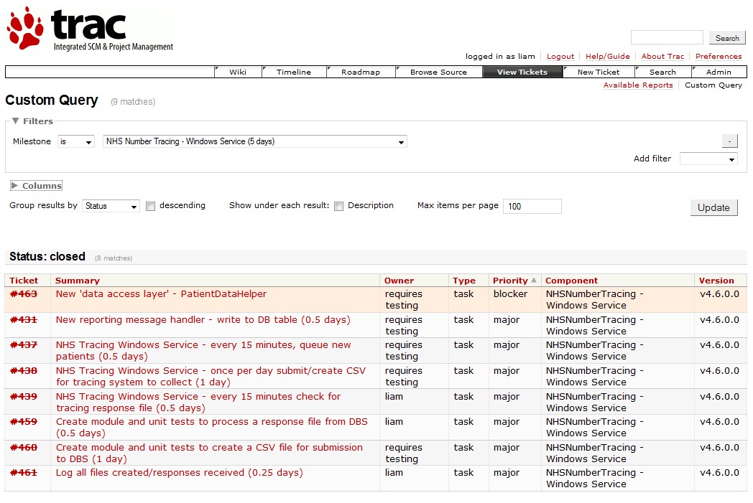
No.4 – Estimating time and costs
π
\
2
rule
Notes:
Estimating times and costs – this is an art and not a science. PI rule is predicated on fact that whatever initial estimate you provide for time/costs, it is likely to run over budget, so multiplying by 3.14 is a good way to handle any missing items. All rules have exceptions, and this one is easy, instead of multiplying by PI, multiply by PI squared – 3.14 x 3.14. Even this rule can be broken, NHS Choose and Book went for PI cubed, before finally being asked at a cost of £billions.
Simple estimates give me that sinking feeling – if a 3rd party provides an estimate before they’ve even seen your specification document you know you will be in trouble.
Personally any ‘estimate by tomorrow’ I provide is always stated to be provisional. When I worked as a solo consultant I used Trac to create individual work tickets, which were very fine grained, certainly never longer than one day. You can use anything to do this; Trello, Mingle, Jira, Excel, MS Project, even Notepad. The aim is to arrange work items into milestones based on either completed components or into weekly deliverables this provides a very clear estimate of both time and costs. And those tickets include listing items such as; meetings, creating releases, installation documentation, installation time, post installation write up, and never forget branching/versioning in your source control system.
Timesheets are also important. It’s very hard to estimate future time/costs when you haven’t recorded previous time/cost estimates against the reality of the actual time/cost taken. When internal markets were introduced to the NHS some hospitals lost hundreds of thousands of pounds. They estimated the cost of operations with no analysis of the costs actually involved.

Slide 10
No.4 – Estimating time and costs
\
‘To finish first,
First you have to finish’
Ron Dennis, McLaren
Notes:
As the Duke Nukem Forever team discovered, you may have the best game engine, the most awesome graphics, with completely immersive gameplay but unless you actually ship the product no one will ever find out.
This does not only apply to complete products, but to beta versions of commercial products. At a Thoughworks briefings, Giles Thomas, Managing Director and CTO of Resolver Systems, discussed the development of the IronPython based Resolver One spreadsheet. He commented that they were hampered to some extent by having too much startup funding; they were secure enough that there was no need to place early betas of Resolver One in client hands to encourage sales. This meant that when clients finally got access to Resolver One, some features were eventually modified heavily or scrapped, a waste of both time and money that may have been prevented by regular beta releases to select clients.
For bespoke software products such as the Hat Trick Ticketing System regular betas were provided to the end user, and future work tickets were modified, and even deleted as it became clear they would no longer be required. The time/cost estimate is a continuous process which really only stops after delivery of the software, and may even continue past delivery with final documentation delivery as well as ‘snagging’ items (small fixes that do not prevent use but require completion).
.. and always remember if you charge maintenance or support fees, spread them out over the payment period and do not treat them as working capital for other projects.

Slide 11

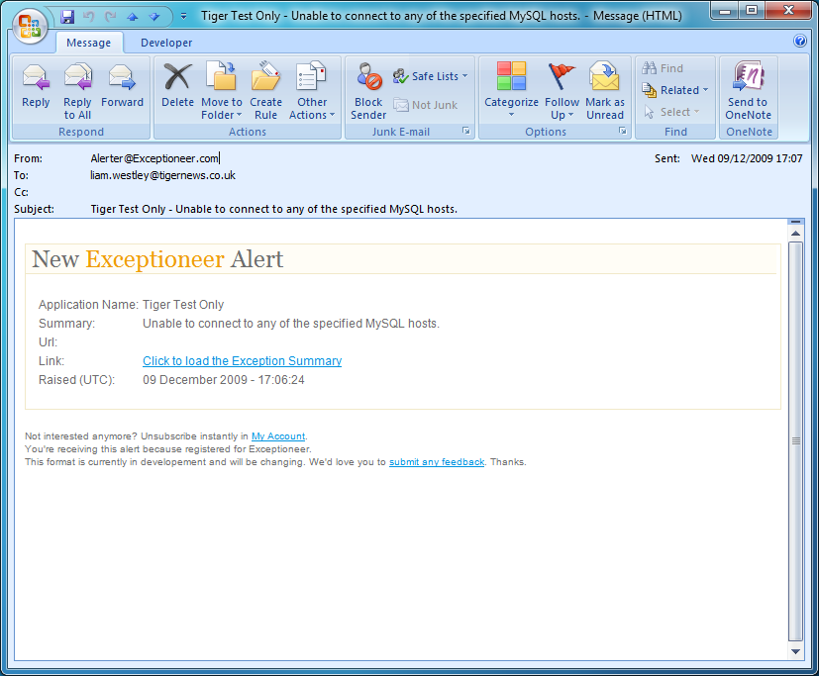



No.5 – Get organised
\
Notes:
If you have contracts that you have to sign, read them. If you don’t understand terms get the client to clarify them. If you require clauses to be modified then mention it immediately. And do so in writing (e-mail or letter). Keeping records is dull, but necessary. I have years of old e-mails, messenger history, and timesheets. I fill out a timesheet every day, including client codes (and I’m a one man company). If you don’t keep timesheets every day recording what you have done then it is very likely that your invoice at the end of the month will be a complete work of fiction. Even when I became permanent at CriteriaMX I kept up the habit of a timesheet which did come in very handy, together with commit comments for solving ingestion issues we had when transcoding media files to MP3.
<tweets / e-mail noises – Apologies, CLICK to read email – then dial on the phone, tell them to check internet connectivity, check that MySQL on public web server is running, and just in case you can restart the public web site synchronisation service’ CLICK to hide email>
If the client has processes and procedures, follow them, even if their employees do not. At one of our NHS trusts, a IT network admin modified our server permissions, broke the application and the IT support insisting on a change request to have them put back despite the fact that the IT network admin had not filled a change request form for his modifications to the server.
Meetings part 1. If you are to take part in meetings, always try to request an agenda several days prior to the meeting itself. If you are calling the meeting, or if no one has written an agenda, create it yourself and distribute it to all the participents. Meetings without agendas (and therefore a purpose) are bad enough in a corporate environment but with external clients it generally swallows at least half a day during which you won’t be working for anyone else. Finally, always confirm a meeting the day before by telephone or e-mail. For me, something like 20% of meetings are cancelled with less than 48 hours notice and very often without any notification that they have been cancelled.

Slide 12
No.5 – Get organised
\
‘Those who tell the stories
rule society’
‘Victory goes to those
who write the minutes’
Liam Westley
Plato
‘History is
written by the victors’
Winston Churchill
Notes:
Meetings part 2 – and while the agenda is useful for setting the expectations for a meeting, the minutes of a meeting are much more important.
The best thing that could happen is that you get to write the minutes, but if you don’t, request a copy via e-mail and if you disagree with any of the items, or something has been missed, respond quickly with suggested amendments. I am always amazed by the number of people who, a) never read minutes at all and b) never challenge them.
Action Points (or TODO’s) are by far the most important bit of any minutes, if you write them, make it very clear who owns any issues and expected completion times.
Good example of being organised is typified by support incidents. QVC had a spreadsheet template for reporting faults, they invariably failed to fill them out correctly or send via e-mail but we logged all support calls. A single spreadsheet included whether the issue was resolved, the time taken to resolve, and whether it was a fault due to QVC or due to Tiger Computer Services. Although the support engineers didn’t really pay attention to this, the departmental managers were quite keen to see just how many faults were as a result of internal procedures not being followed correctly. In turn, they improved their internal systems, silly faults were resolved much quicker and we received less support calls.
Another top tip – if you do have outages, always provide a report when the system is restored via e-mail to the support team, the departmental manager and, crucially, the person who signs off the invoices. Being open about faults like this is an easy win, as it provides the positive news that a problem has been fixed.

Slide 13




No.6 – Sales
\
stock.xchng
http://www.sxc.hu
Notes:
Sales – try to think like you client. What benefit will you deliver? Is there anything unique about your offering, and if you can, work out who will actually be signing off the budget for the project and any future payments such as maintenance or support.
Also when pitching for a sale, it is vital to put some effort into researching the client’s operations. When QVC wanted a text to screen service we pitched against bigger companies. When I chatted to the interactive team after winning the pitch, they revealed I was the only person who appeared to have watched the shopping channel, and certainly the only one who included references to the previous days Today’s Special Value item within the presentation at the sales pitch.
It’s rare that the end user of your systems is the person who will have much financial clout, it may reside within the department head or even the Financial Director. You need to think about why the person signing off on your purchase would justify that expenditure. These may be intangible benefits (at QVC text to screen is customer service) or have a proven financial payback (Hat Trick Production’s new ticketing system implemented an e-ticket system, saving money on printing costs, mailing costs and therefore providing the money for me to write the system).
Signing limits come into their own at this point. I believe that the Hat Trick Productions budget for the new ticketing system was capped at the Head Of Human Resources signing limit (they are in charge of IT). At QVC monthly invoices were changed to three monthly invoices when a reorganisation resulted in my invoices being signed off by someone with a higher signing limit, who didn’t want the bother of signing of small amounts every month.
Also at QVC the 3 month pilot phase had an upfront development fee followed by three monthly installments, ensuring no invoice exceeded £1,500. This also created the concept of a monthly fee for the service.

Slide 14
Summary
Do your best to eliminate support calls
Test your software as much as possible, it’s not the job of your client
If it escapes testing; log it, fix it
When estimating time/costs small work items are best
Always aim to be more professional than your client
Sales – think like your client
Notes:
Summary :
Your goal should be to eliminate support issues, or at least make them transparent to the end user.
Testing your software at every step is not optional.
If you haven’t caught something in testing, at least log it properly so you can remedy it.
Breaking down big projects into individual work tickets is the only way to get an accurate estimate, and you’ll still likely to overrun even then.
Organise yourself - always aim to be more professional than your client.
Always try to place yourself in the viewpoint of the client – how will they justify paying money for your services, and who is really responsible for signing off a project and what is their likely signing limit.

Slide 15
Resources
Don't Just Roll The Dice, Neil Davidson (Redgate) – a free eBook on pricing software
Software Runaways (Lessons Learned from Massive Software Project Failures), Robert L Glass
The Inmates Are Running the Asylum, Alan Cooper (chapter 3, ‘Wasting Money’)
The Mythical Man-month, Frederick P. Brooks, Jr
Notes:
Summary :
Don't Just Roll The Dice, Neil Davidson - a free eBook from one of the founders of RedGate on how to price software
Software Runaways (Lessons Learned from Massive Software Project Failures, Robert L Glass - the title says it all!
The Inmates Are Running the Asylum, Alan Cooper - a classic on software UX design, but check out chapter 3, 'Wasting Money‘
The Mythical Man-month (Essays on Software Engineering), Frederick P. Brooks, Jr - managing software projects

